Slide 1
Who,What,Where?
Team
4
Designed by Team Cyberpsychosis Studio:
胡文博 周振亮 田子牧 蒋浩成

Slide 2
01
Game Overview
02
How to play
CONTENTS
03
Content
04
Challenge

Slide 3
01
Game Overview
background/purpose/……

Slide 4
01
Game Tags
RPG (upgrading,collection,boss,…)
Exciting Bosses
Magic World
Freedom & Customize
Fighting & Exploring
Mixture of Machanism

Slide 5
01
Background
Not knowing how mach time has passed, you wake up and find yourself in a mystery world, and EVEN NOT HVING A HEAD?Who are you? What are you going to do? And where will you go? The only thing you do know is danger is coming and you have to survive.
不知过了多久，你从混沌中醒来，还失去了脑瓜子
身处陌生世界。四周危机四伏，时间紧迫。
你必须依靠直觉，向西寻找生机，揭开谜团
先活下去！（敬请期待）

Slide 6
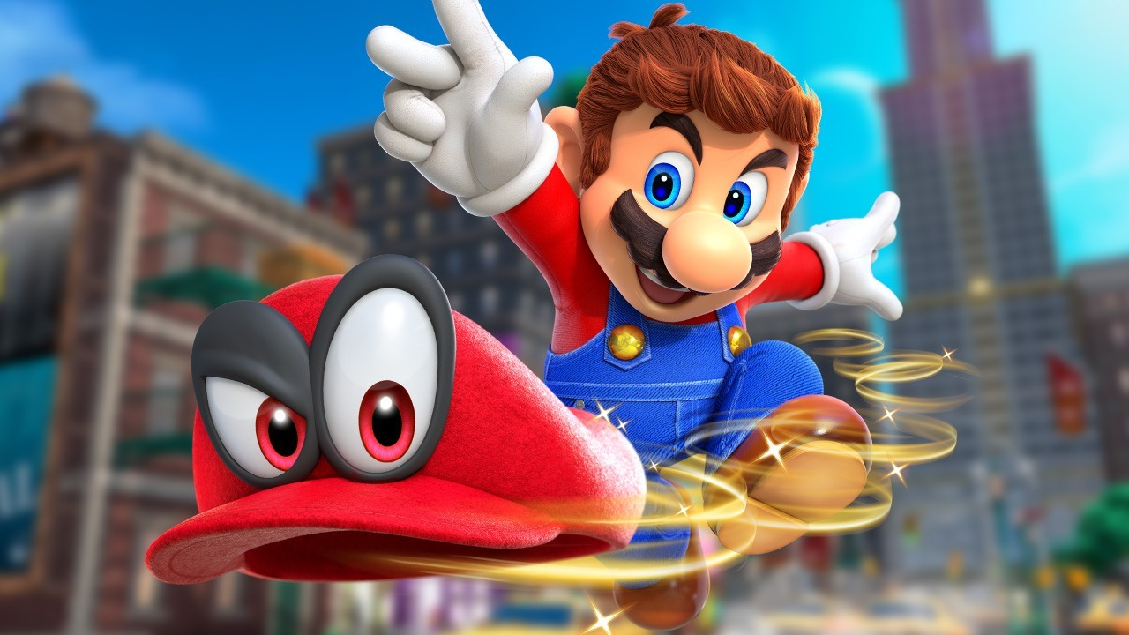
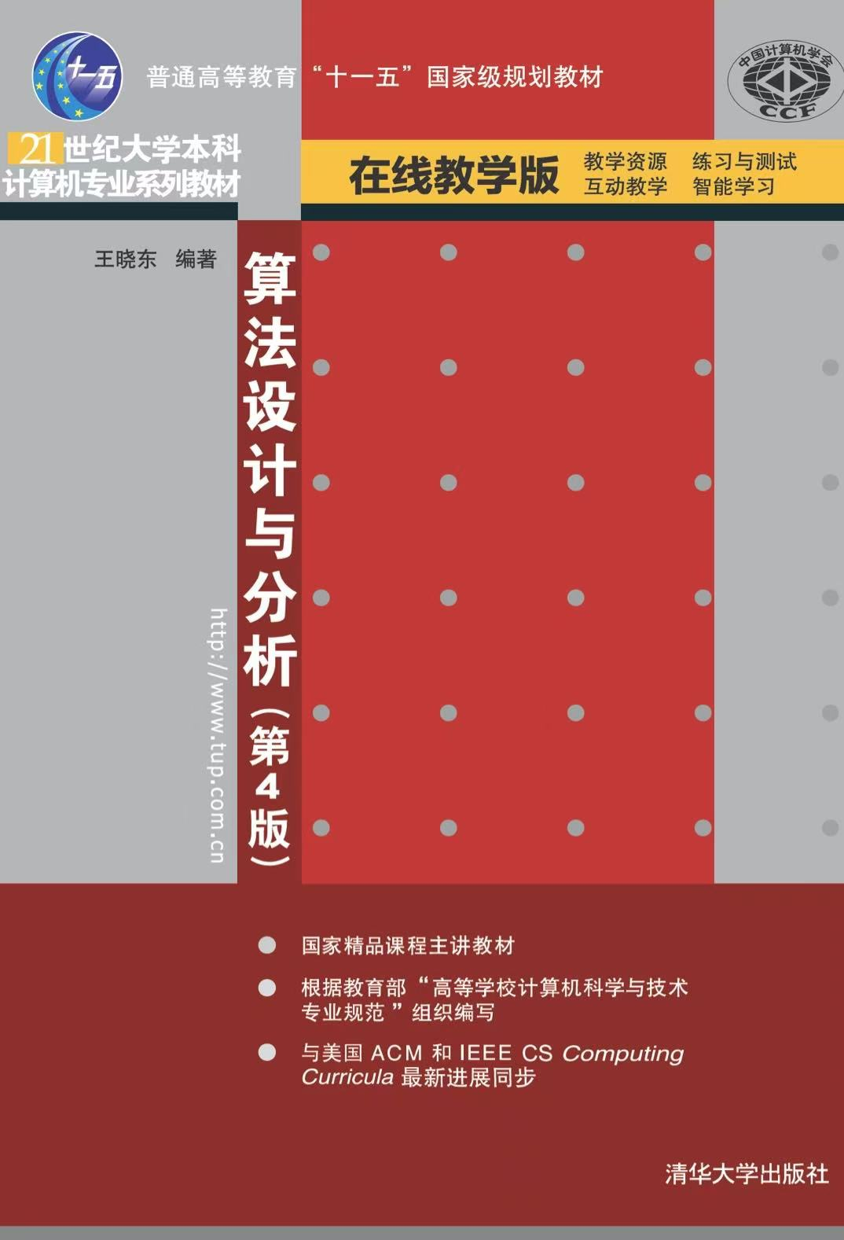
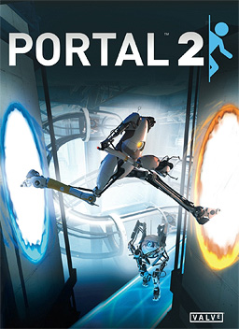
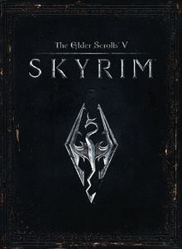
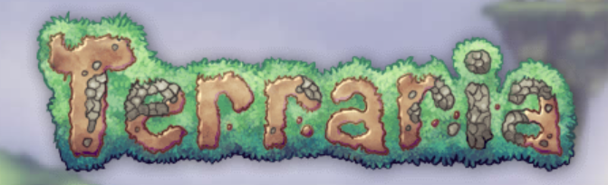


1
01
Source of Inspiration
The idea comes from Great Games made by Predecessors
We will have:
Freedom of Terraria/Skyrim: In our game, we will have countless skills and items. You can customize your adventure in any way you can imagine
Fast-pace Combat & Random Generated Map of Dead Cell, with favorite weapons and magic, it’s your show time.
Shape-Changing of Mario Odyssey
Shortcut for Clumsy Players: With our enormous features, you only need imagination.
These games inspired us!

Slide 7
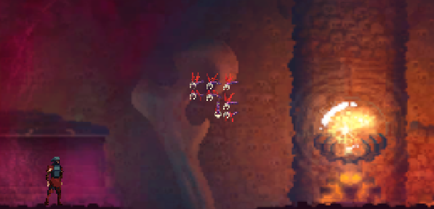
1
01
How our game look like now?
Standing on the ground, how to attack an flying enemy?
In our game, you can:
老套：等敌人俯冲下来 被动
老套：使用远程攻击 （万一射程不够？）
如果你有一把传送枪?
如果你有一条钩爪？
如果你能召唤能飞/能打到它的小兵？
如果你能将它石化？
如果你能将重力颠倒？
如果你能放墙把它关起来？
先跑，等能飞了再回来
…….

Slide 8
02
How to Play

Slide 9
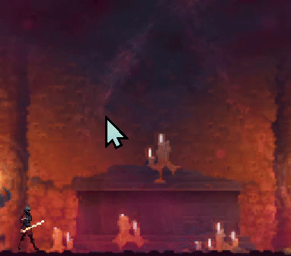
Winning condition: Arrive Destination & Answer the Title
Losing condition: Lost your Life
02
Are you tired of complex upgrading system that is hard to grasp？
Don’t worry, ours is simple
Rule1:Reassign your ability points at any time
Rule2:Getting Ability points when upgrading
(enemies upgrade too!)
A/D: Move
Space: Jump
Mouse1: Attack
E/F/C/…: Skills
Roll: Switch weapon/items
Life(血量): 血量
Defense(防御): 防御力
Agility(敏捷): 移动速度，冲刺距离与僵直时间
Attack(攻击): 攻击力，攻击范围，攻击速度
Wisdom(智慧): 法力值，魔法伤害
Talent(天赋): 升级速度，击败敌人获得的经验
Shift: Dash

Slide 10
02
Achievements & Upgrades
Defeating enemies: gain exp and skills
Defeating Boss: gain Boss Skill and their soul(used for what?)
Upgrading: Abillity Points
…………

Slide 11
03
Content

Slide 12
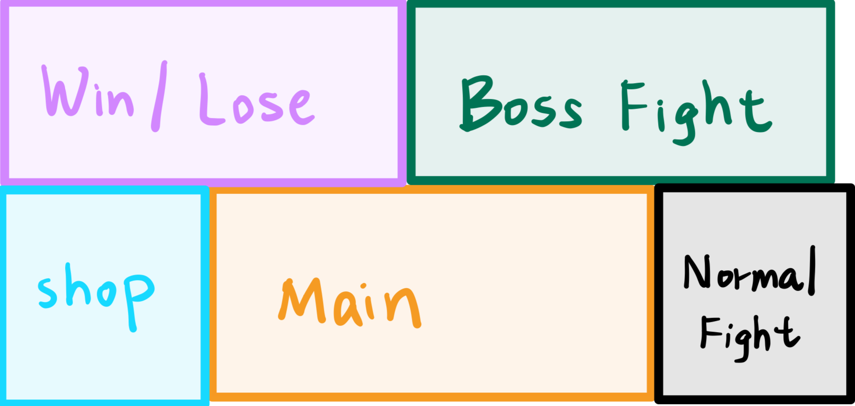
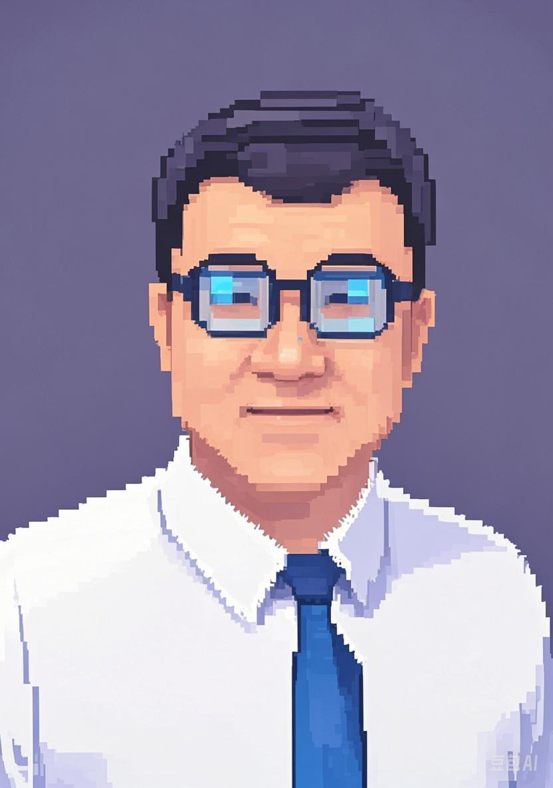
03
Boss
珈因.king
技能：
P/NP/NPC/NPH 子弹
分治
动态规划
贪心索敌
堆草堆
更多想法，欢迎投稿至tett8107@gmail.com

Slide 13
03
Skills & Items
We will have these skills：
I. 魔法：火球，法阵，亡灵魔法
II. 隐身
III. 分身
IV. Boss技能(例如：分治？）
Ⅴ. …….
We will have these items：
I. 传送枪
II. 钩锁
III. 筋斗云
IV. 激光枪
Ⅴ. …….

Slide 14
04
Challenge

Slide 15
04
Design skills?
Implement action animation?
Skill Combination?
Strange Machanism?
EVERYTHING IS CHALLENGE

Slide 16
THANKS

